Slide 1

Computing Algorithms 12th Week Project
Done By :
Abdalrahman Sherif Ibrahim – 20107171
Nadine Mohammed – 20107088
Sara Ashraf - 20105551

Slide 2
Project Idea: (6)
Project 6 Write a code that constructs a graph. After creating the graph, the code should check whether the graph is: a. Connected. b. acyclic. The above check will be done using Depth-First-Search (DFS) and implemented by both adjacency matrix and adjacency list.

Slide 3
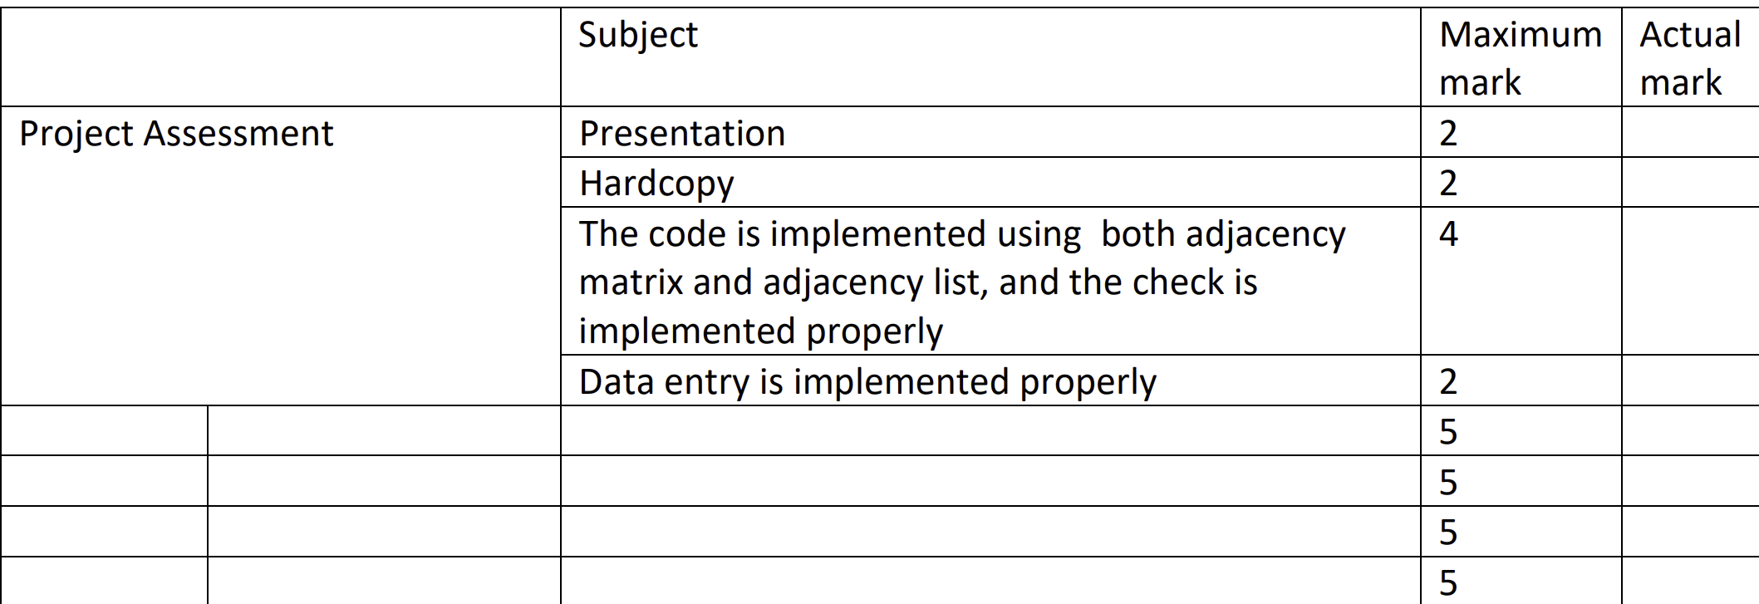
Rubric

Slide 4
Objectives:
Explain the difference between Acyclic and Cyclic graphs.
Illustrate the difference between connected and disconnected graphs.
Explain the code implementation and demonstrate graph visualization.
Present and discuss different inputs to showcase the differences.

Slide 5
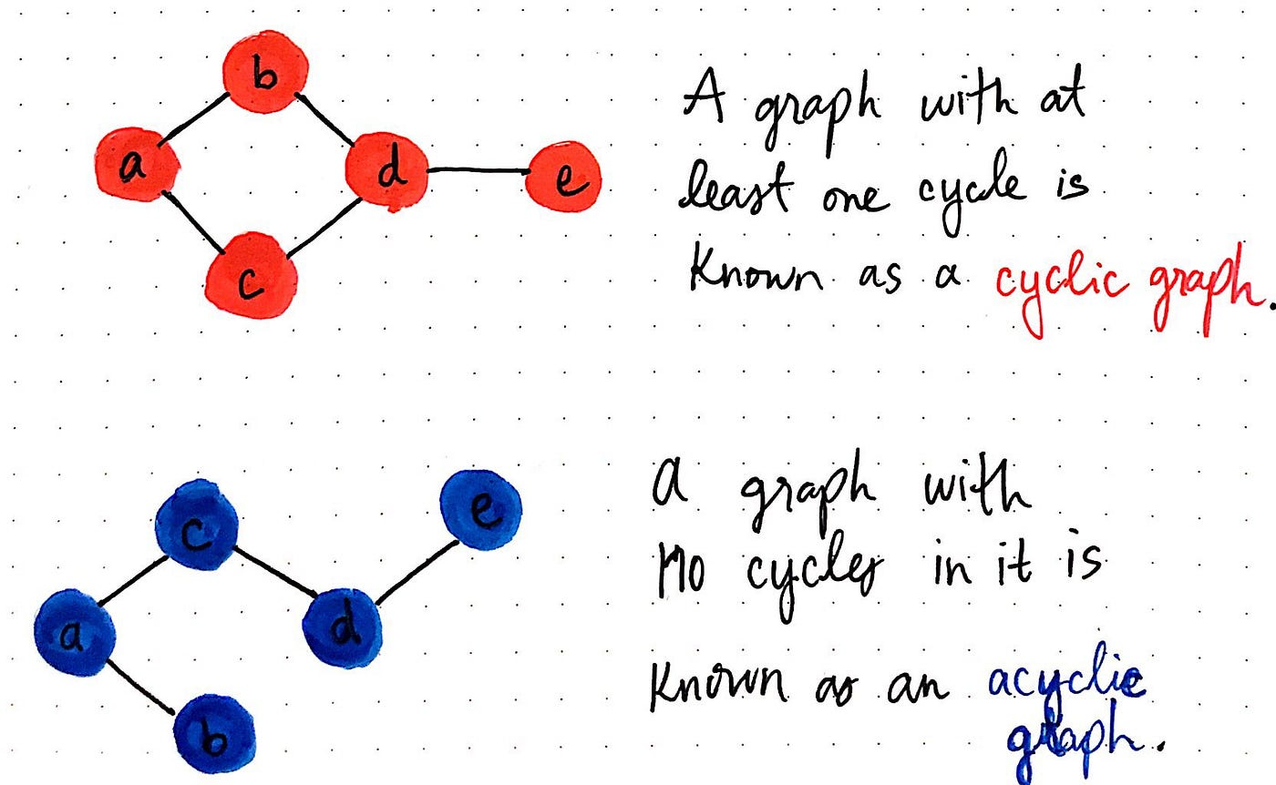
What is the difference between Cyclic & Acyclic graphs?
A graph that contains at least one cycle is known as a cyclic graph. Conversely, a graph that contains zero cycles is known as an acyclic graph.

Slide 6
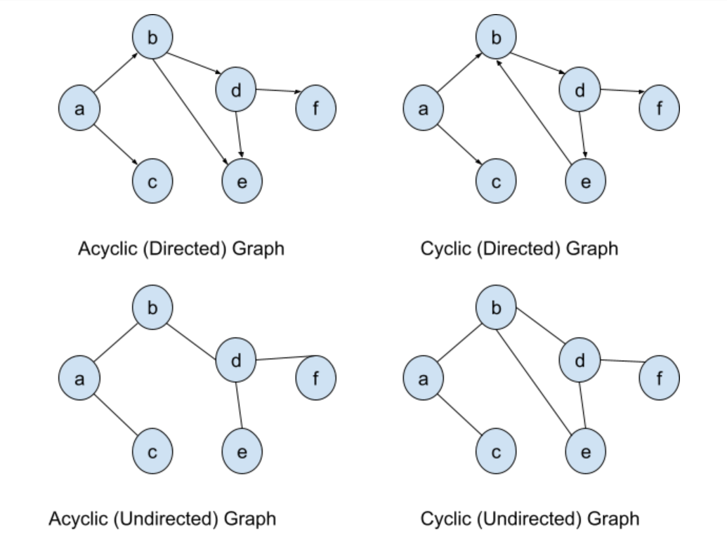
Additional examples for illustration.

Slide 7
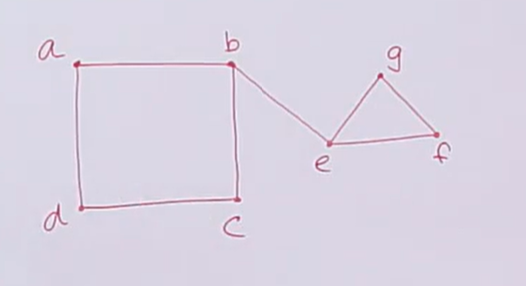
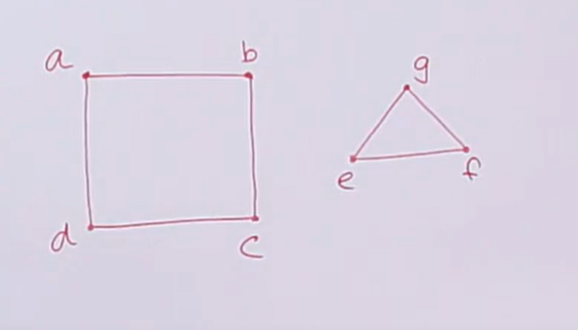
2. Illustrate the difference between connected & disconnected graphs.
A graph is said to be connected graph if there is a path between every pair of vertex. From every vertex to any other vertex there must be some path to traverse. This is called the connectivity of a graph. A graph is said to be disconnected, if there exists multiple disconnected vertices and edges.

Slide 8

3. Code Implementation (step-by-step) using Python.

Slide 9
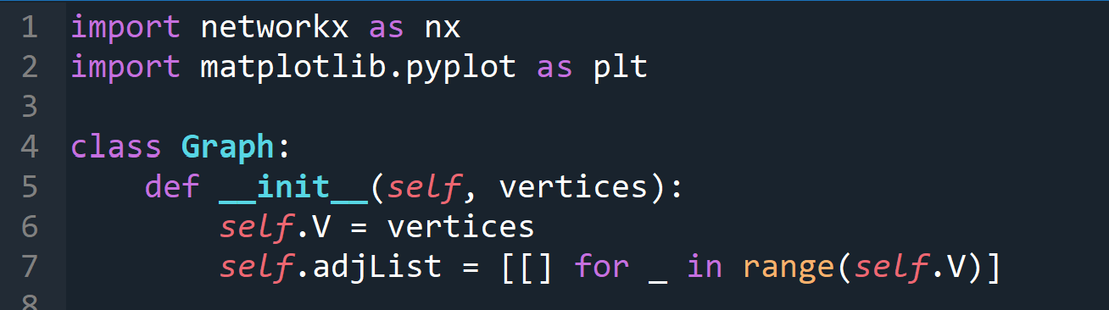
Importing libraries , Defining & initializing the graph class.
Import libraries
Define the graph class
Initialize the graph.
O(1)

Slide 10
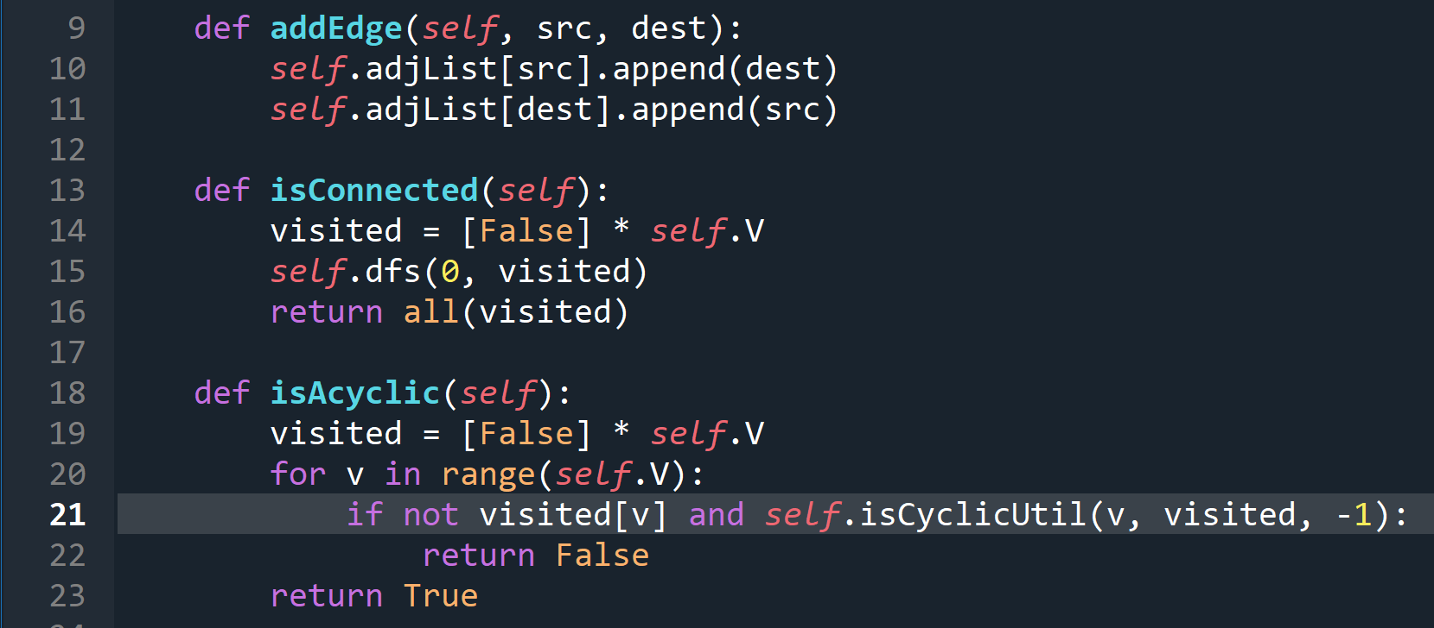
4. Add edges to the graph
5. Check if the graph is connected
6. Check if the graph is acyclic
O(1)
O(V+E)
O(V+E)

Slide 11
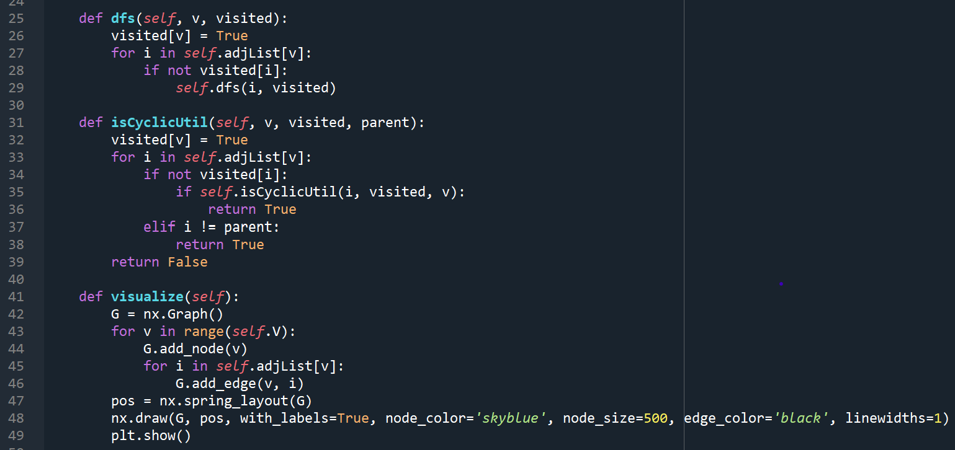
7. Performing Depth-First Search (DFS): 8.Checking for Cycles using DFS: 9.Visualizing the Graph:
O(V+E)
O(V+E)

Slide 12
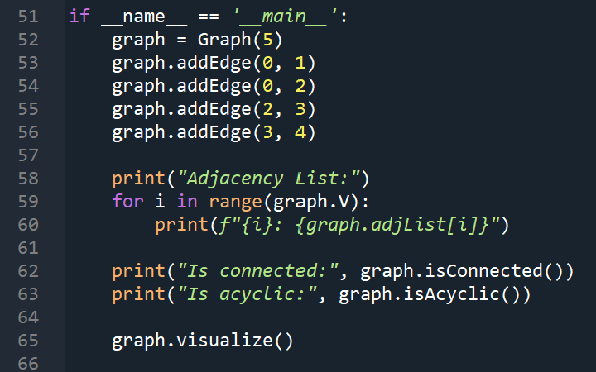
Main function

Slide 13

4. Present and discuss different inputs to showcase the differences.

Slide 14
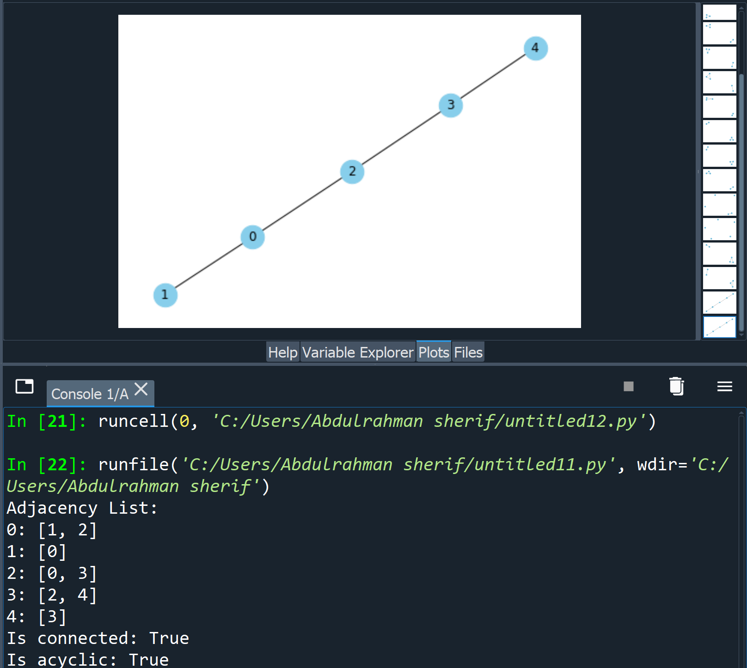
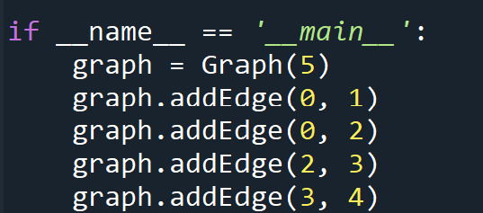
In that case the graph is acylic & connected.
1

Slide 15
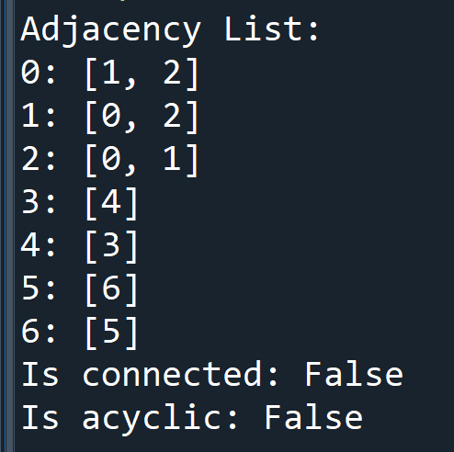
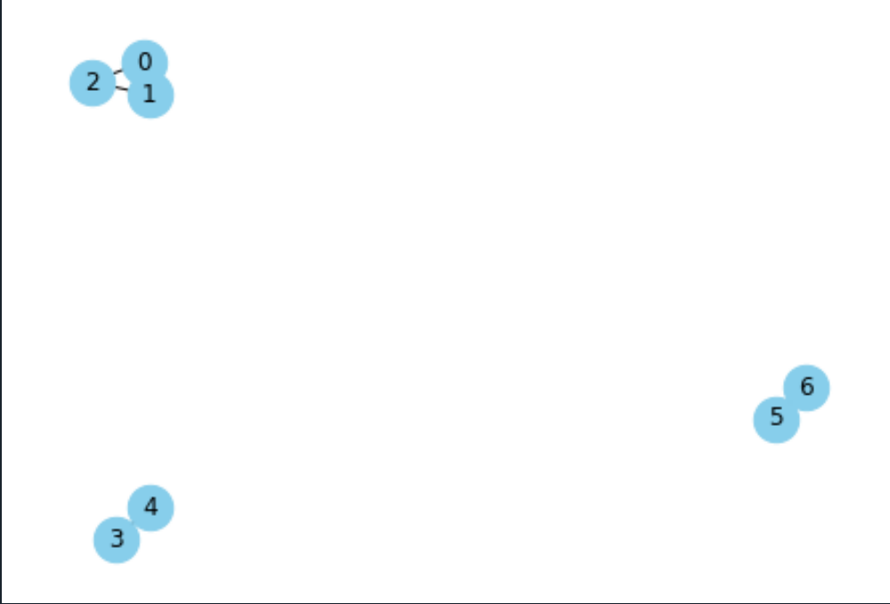
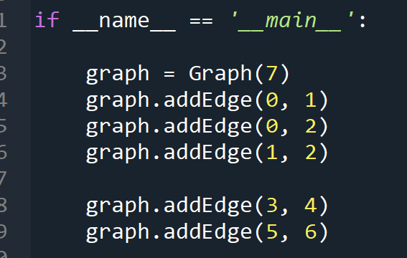
In that case the graph is cyclic & disconnected.
2

Slide 16
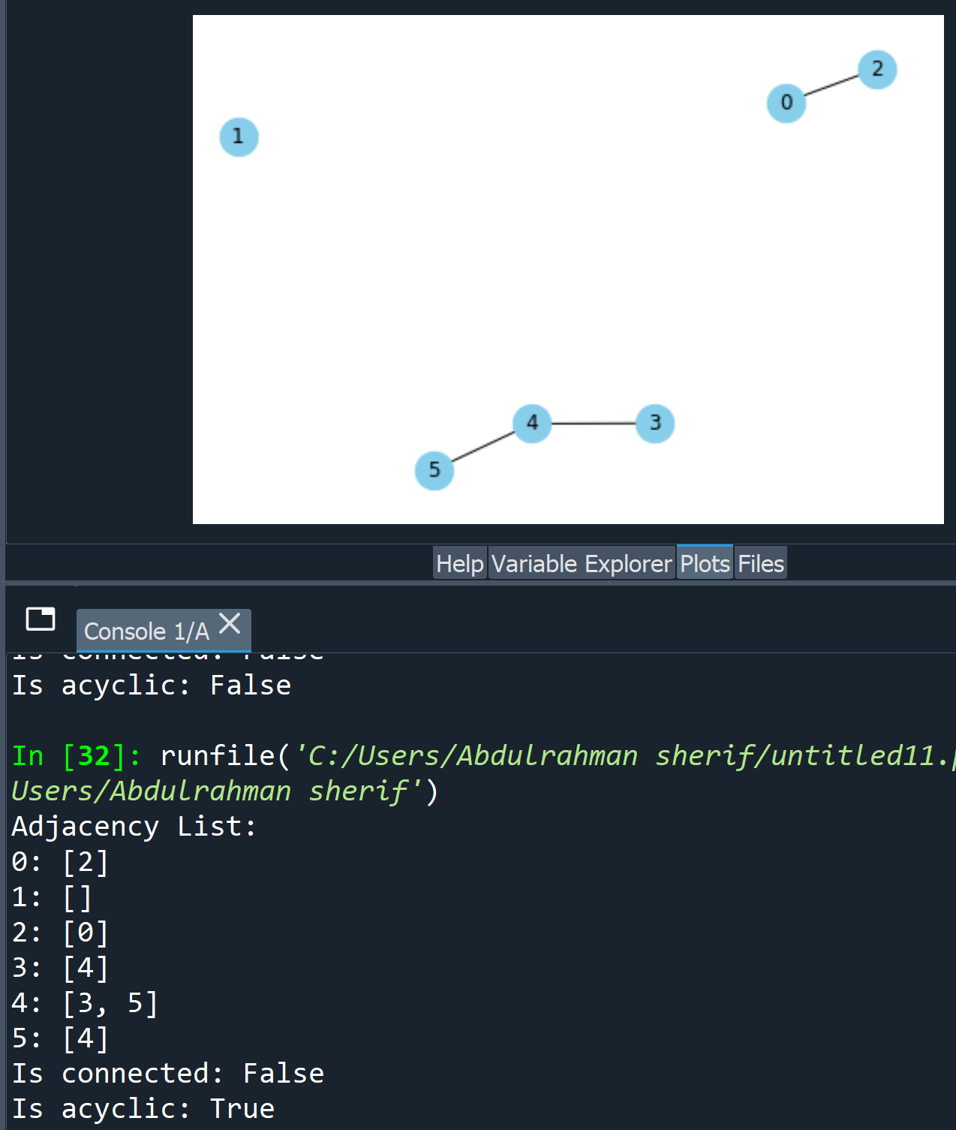
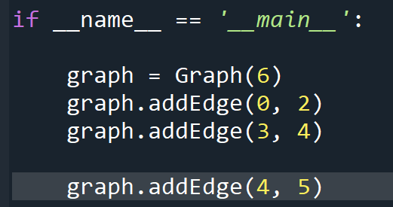
In that case the graph is acylic & disconnected.
3

Slide 17
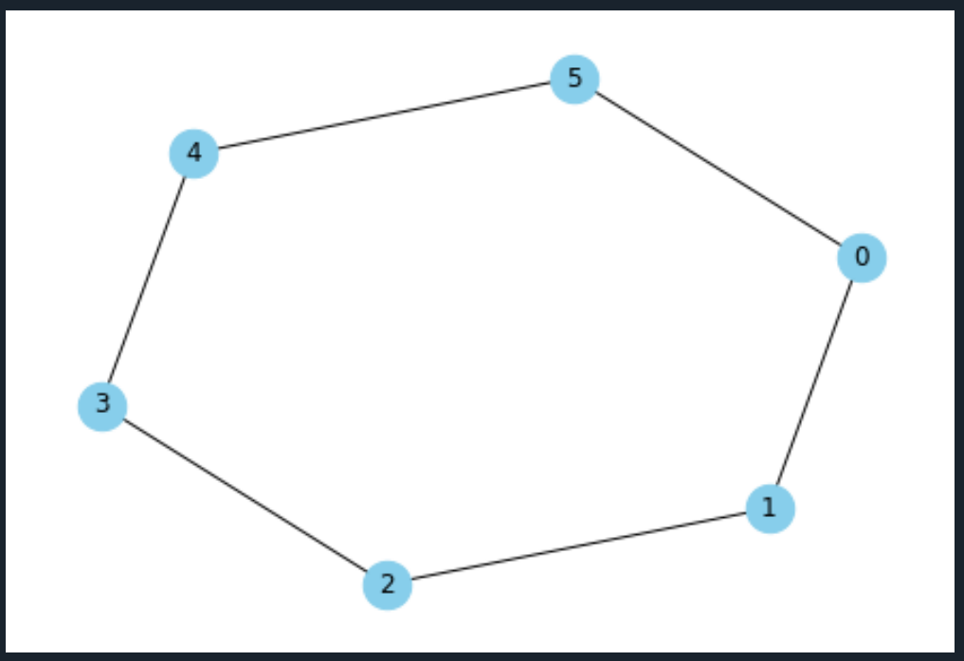
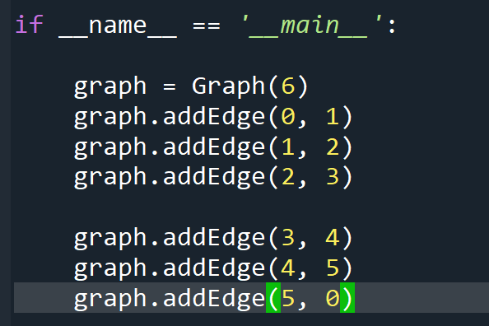
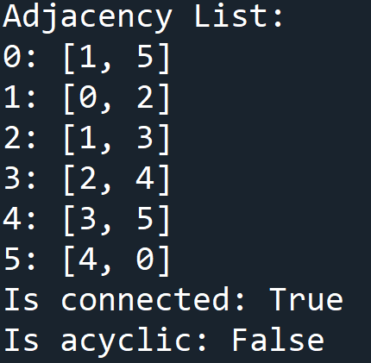
In that case the graph is Cyclic & connected.
4

Slide 18

Conclusion
In this project, we learned about graphs and their properties. We implemented code to determine if a graph is cyclic or acyclic, as well as connected or disconnected. The visualization feature helped us better understand the graphs by displaying them visually. Overall, this project provided an introduction to graph theory concepts and allowed us to explore different types of graphs.

